Slide 1
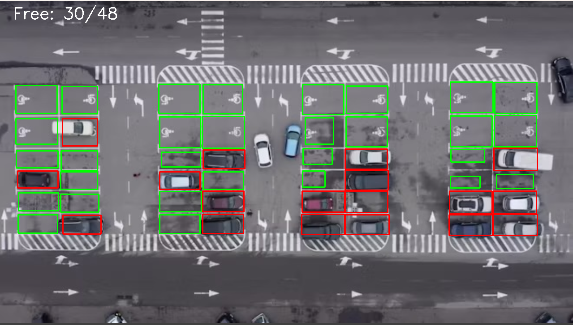
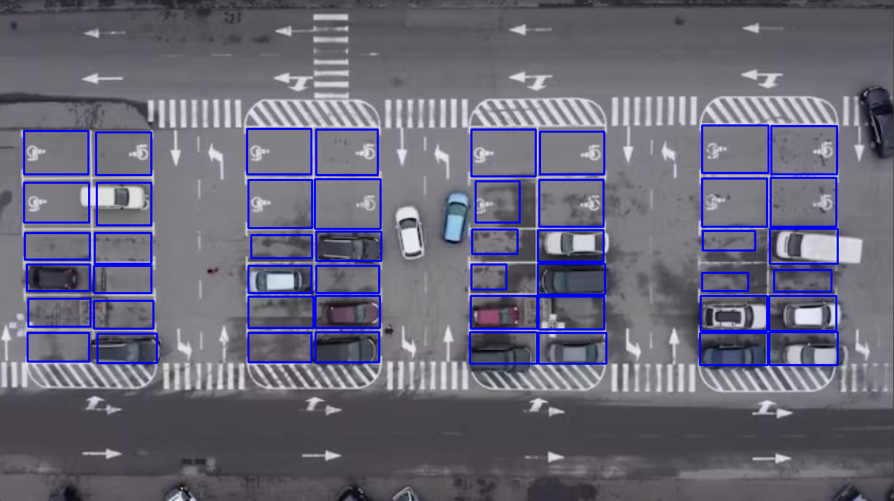
Parking CV by Jacob Holt and William Bolsen
This project will leverage computer vision to identify and report whether parking spots are occupied.

